Slide 1
Luganda voice-controlled wheelchair project
Project progress
Samuel and Adi

Slide 2
Recap
The main objective is to develop a Luganda voice-controlled wheelchair system
Specific objectives
To collect and curate a Luganda voice dataset for common wheelchair movement commands.
To develop, train and evaluate a speech intent recognition model to classify spoken Luganda commands.
To integrate the trained model with a wheelchair to form a voice-controlled wheelchair system.
To evaluate the system.

Slide 3
Work completed
Reading the literature review of the existing systems
Determining the hardware components to use for the project
Getting a google dataset to use to train an English version of the model
Getting the commands to use for the project
The wake word to use in the project

Slide 4
Commands
Command in English | Command in Luganda
Wake word | Gaali
Forward | mu maaso
Backward | okudda emabega
Stop | okuyimirira
Right | omukono ogwa ddyo
Left | kkono

Slide 5
Hardware components
Boards
Microphone
Motor driver
Motors
Speakers

Slide 6
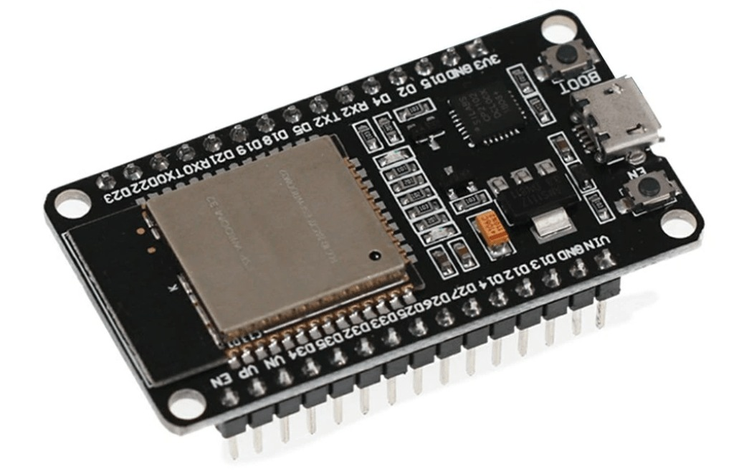
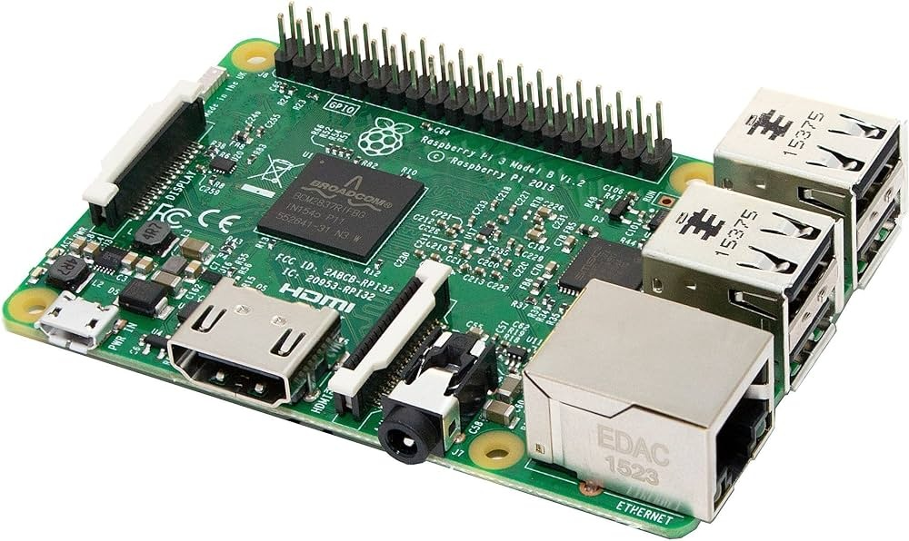
Deployment
ESp32
Deploying the wake word on the ESP32 board
Raspberry Pi
Deploying the speech intent model

Slide 7
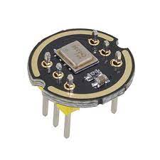
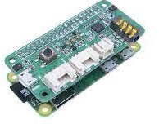
Speakers
reSpeaker 2-Mics Pi HAT
Has 4 analogue microphones
Voice Interaction algorithms of VAD(Voice Activity Detection), DOA(Direction of Arrival), KWS(Key Word Spotting)
WM8960 Audio Codec: Low power, high-quality stereo Codec
Controllable Peripherals: Provide 3 programable APAI 02 RGB LEDs and 1 User Button for attached Speech
Recognition usage
Mems Microphone Module with12C
High Precision & performance
low-power
digital output
Direct connection to board
High signal-to-noise ratio
wideband frequency response

Slide 8
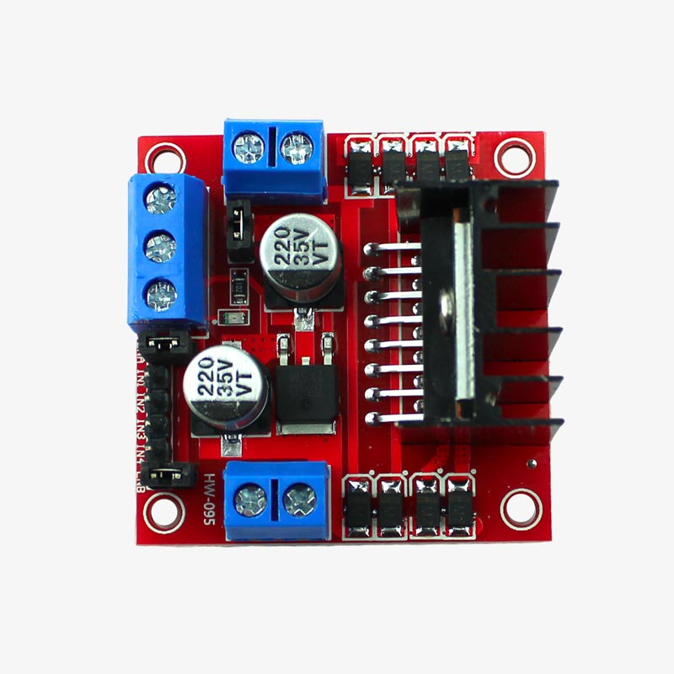
Motor Driver
L298N Motor Driver Board
Is a high voltage and high current dual full-bridge
driver it can up to 46V and Dc current up to 4amp controlling motors is needed from microcontrollers, switches, relays.
can control up to 4 DC motors, or 2 DC motors with direction and speed control

Slide 9
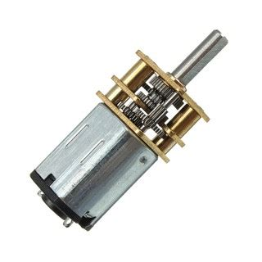
Motor
G12-N20 Geared Mini DC Motor
Medium Power MP: 0.5W Max.
Rated Voltage: 6~12V.
5V -12V
300 RPM
Brushed contacts.
Relatively Cheap

Slide 10
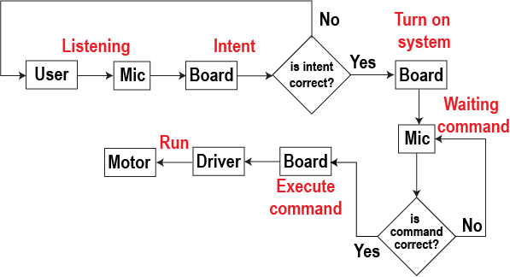
Logic flow

Slide 11
Current status
Still doing literature review
Pending training of the English model
Making slides for the proposal presentations

Slide 12
Upcoming tasks
Purchasing the hardware
Initial testing of the hardware

